Slide 1
Machine-learning-accelerated design of functional structural components in deep-sea soft robots
Mohammed Omair Siddiqui
M00841284
PDE4433

Slide 2
Introduction
To explore the deepest regions of the ocean with high flexibility and environmental adaptability, a soft sea robot is designed using traditional design method and machine learning method and then compared.

Slide 3
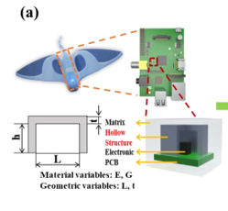
Main goal:
Designing miniature pressure vessels on the printed circuit board to protect vulnerable electronic components on PCB for enhancing the reliability of deep-sea soft robots.

Slide 4
Soft sea robot against traditional robots
Lightweight structure and human friendly
High environment adaptability
Higher Flexibility
Carries batteries and transformers only

Slide 5
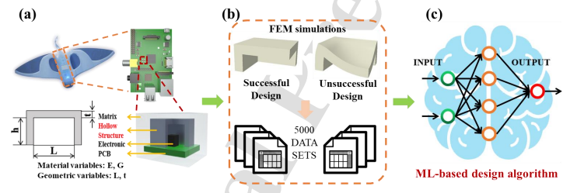
Project development
Description of the design problem (E, G, L, t, h is fixed)
FEM simulations and data set preparation (vertical displacement of the ceiling is < 10% the design is successful or else unsuccessful, 5000 sample set collected over 5 days)

Slide 6
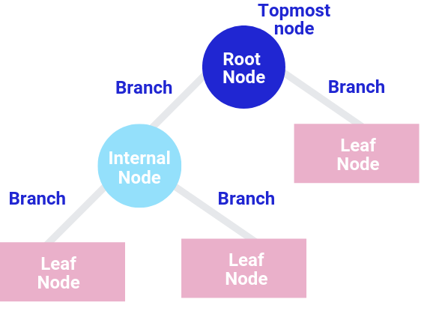
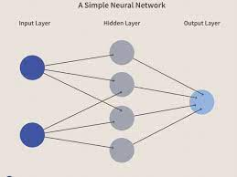
Methodology
Machine-learning-based design algorithm
Decision-tree-based algorithm
Neural-network-based algorithm
Input variable 𝑋 = {𝐿, 𝑡, 𝐸, G}
Target variable 𝑌 = 0 or 1
(A)
(B)

Slide 7
Decision tree
Decision is tree is supervised learning method
Constitutes of root node, into subsets that are represented by a series of internal branch nodes, these subsets repeats, growing the tree till it represent the target variable
X to root node through internal nodes and Y appears on the leaf node
Using Scikit-learn package, classification criterion is set to ‘gini’ and the classification splitter is set to ‘best’
The maximum tree depth is limited to 4-8

Slide 8
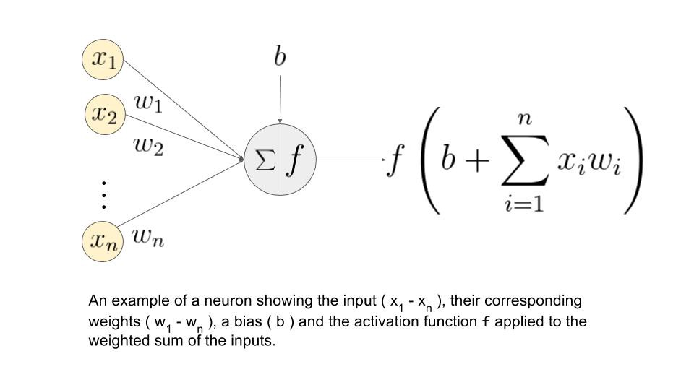
Neural network

Slide 9
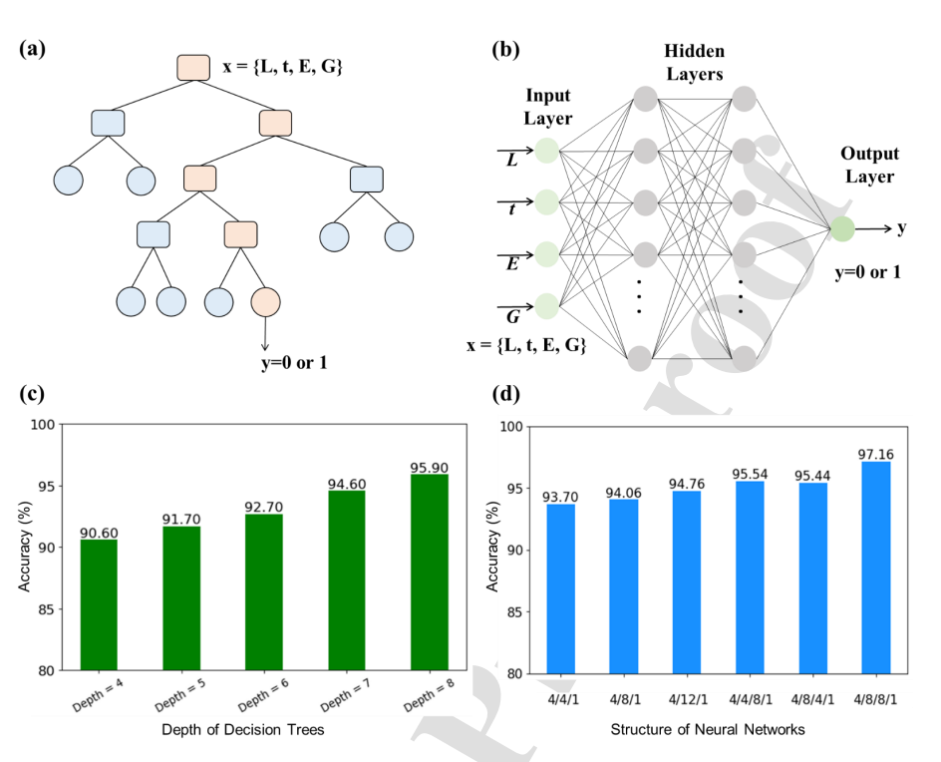
ML algorithm test result

Slide 10
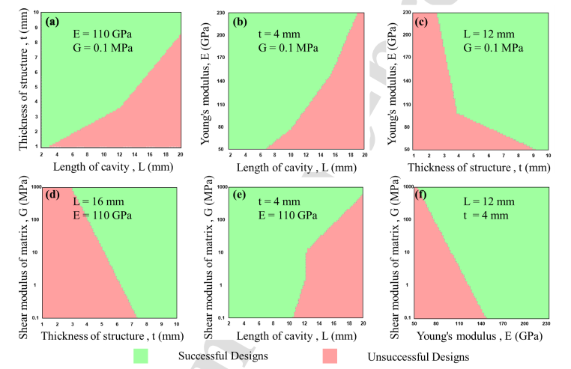
Mechanical rules for the design of miniature pressure vessels
Taking the best performing ML algorithm, neural network (4/8/8/1) , fixing two parameters out of the four for better visualization
(a)t v/s L, (b)E v/s L, (c)E v/s t, (d)G v/s t, (e)G v/s L, (f)G v/s E

Slide 11
Result
ML based algorithm achieve higher prediction accuracy.
From the data set, 80% is the training data and 20% is test data.
Comparing ML predicted Y to FEM predicted Y test data
Accuracy is measured by 𝐴𝑐𝑐𝑢𝑟𝑎𝑐𝑦 = 𝑛/𝑁 ∗ 100%, where n is number of correct predictions and N is number of total predictions.

Slide 12
Conclusion and future work
ML algorithm can accelerate the design of miniature pressure vessels with high accuracy, reducing the time to design the structure by seven orders of magnitude compared to the FEM-based design method. Notably, if trained by appropriate data set, the ML design approach presented in this work can be extended to higher dimensional design space and other shapes for practical applications.

